Slide 1
CINEMY
BY:
NETRA AWATE(001529534)
SAKSHI NAYAK(002193939)
SHREYA BIDARKAR(001550684)
TARU SHUKLA(002193864)

Slide 2
PROJECT OBJECTIVE
A Web application used to recommend movies to the user based on Genre, Language, Actors analysis.
Obtain dynamic search results for each new user.
Allows System Admin to Create, Update and Delete a movie and users to leave a Like on the movie list.

Slide 3
Technologies used
MongoDB, Mongoose
Express
React
Node. Js
SCSS

Slide 4
Functionalities /Features
1- User and Admin account creation and verified login authorization.
2- View all movie listing for User and Admin.
3- Creation, updating, and deletion of a movie by Admin.
4- Search movie by various attributes like name, actors.
5- User like’s or dislike’s a movie recommended by application and watch the video!

Slide 5
SCREENSHOTS

Slide 6
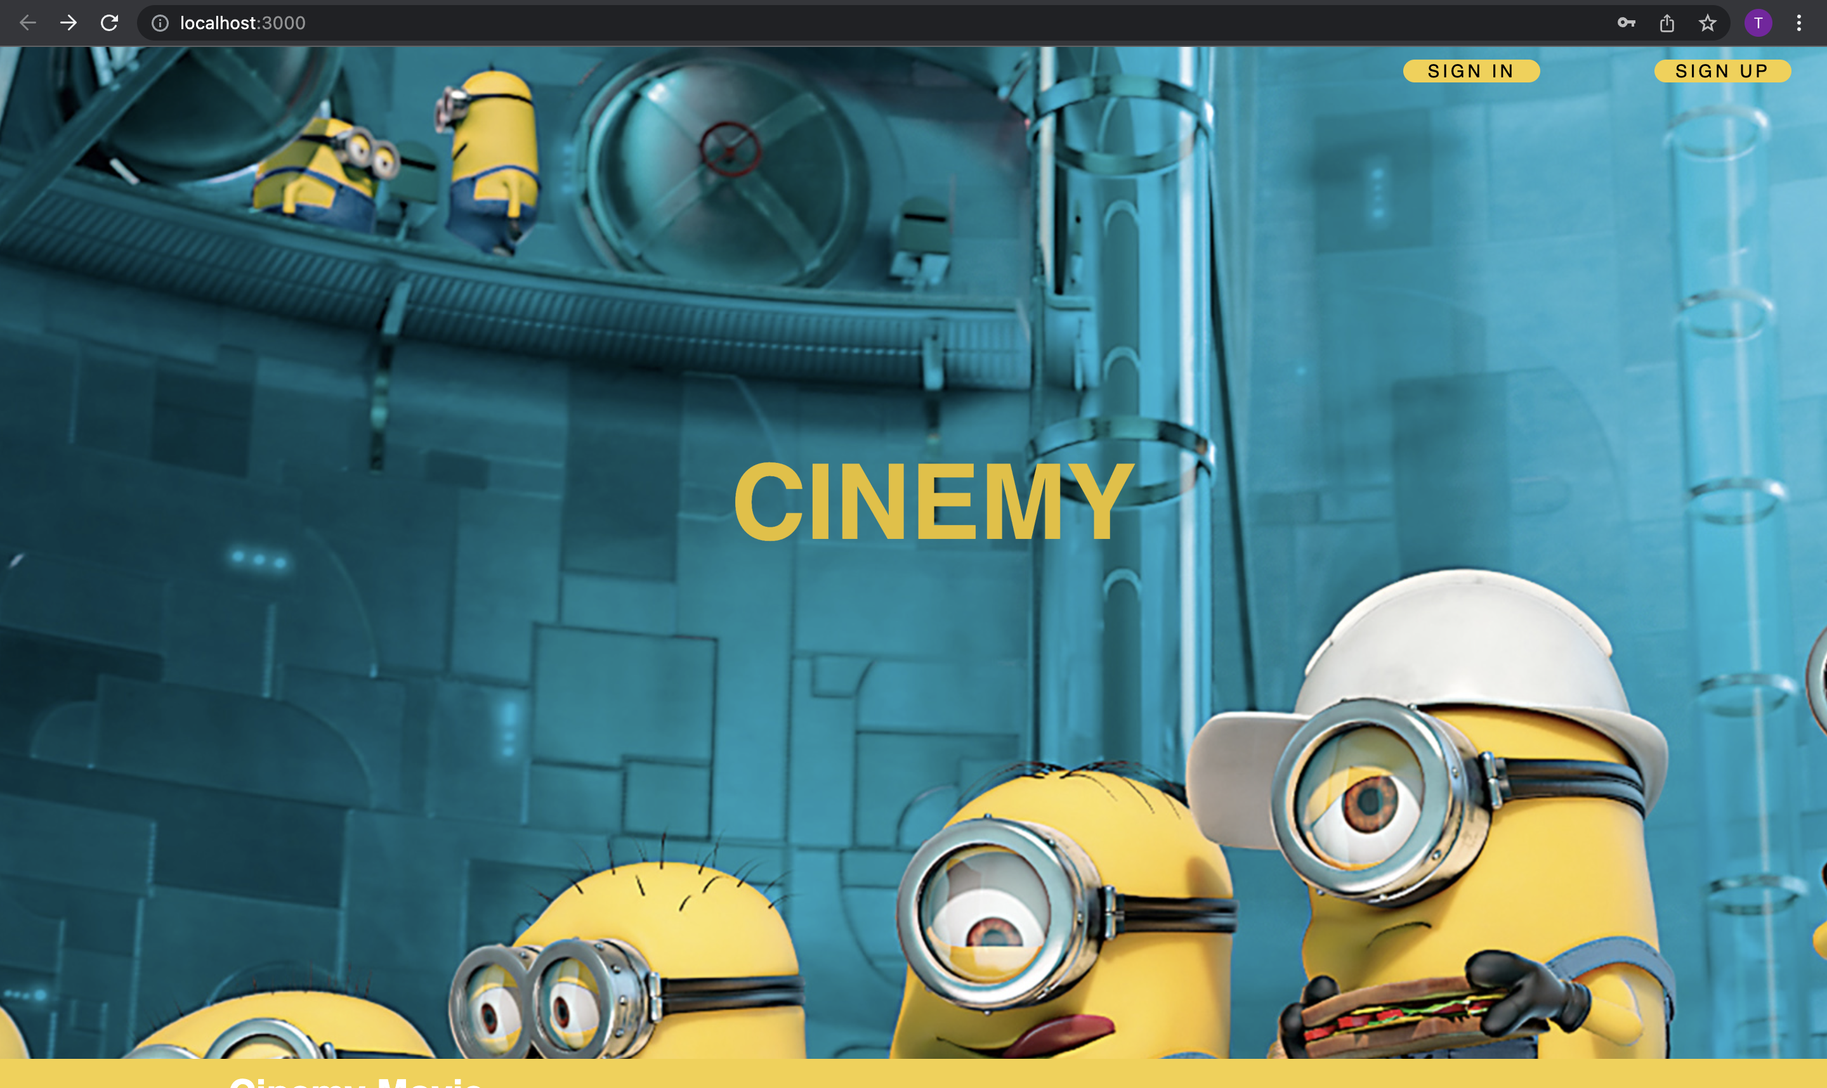

Slide 7
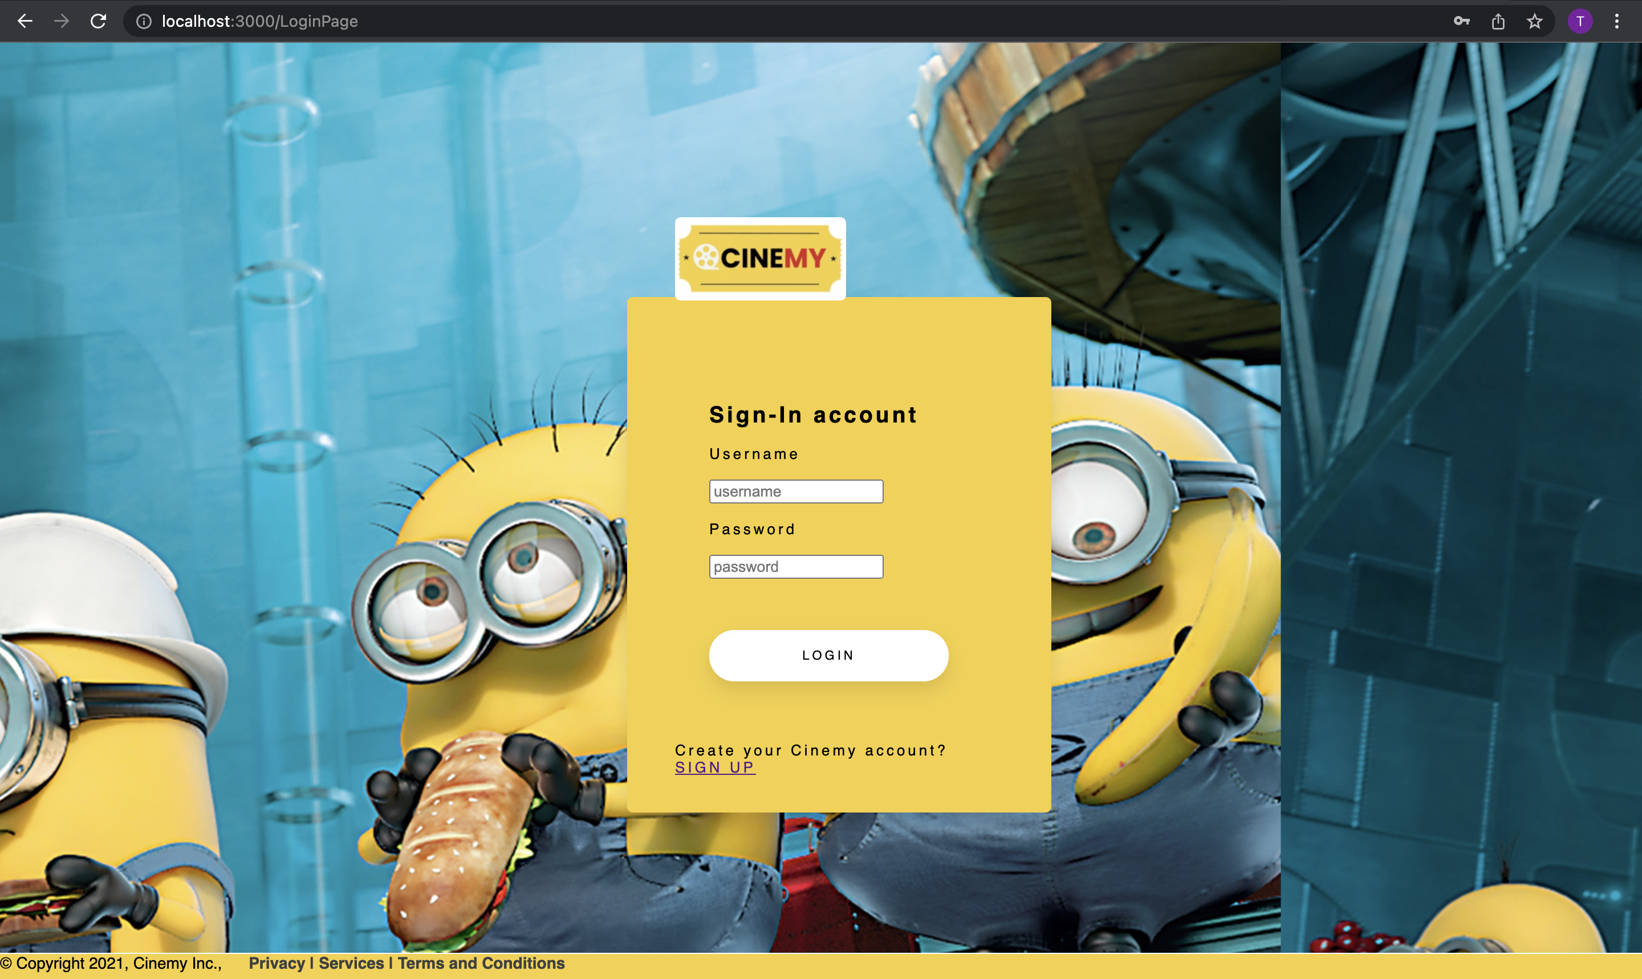

Slide 8
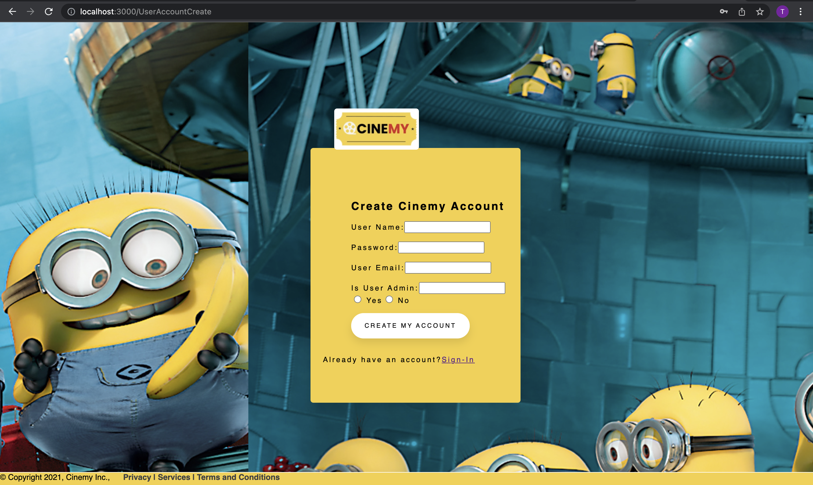

Slide 9
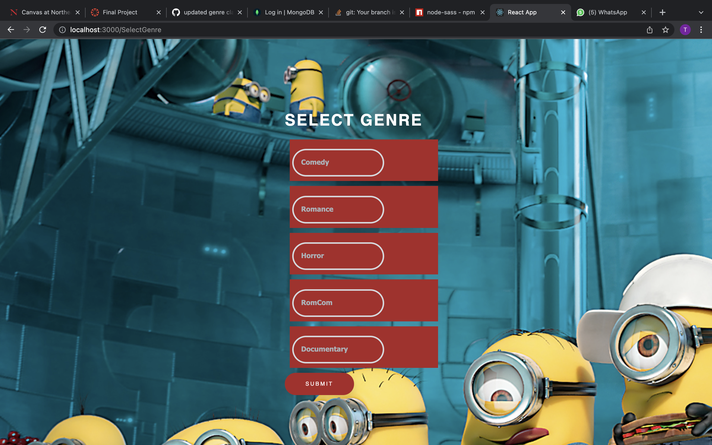

Slide 10
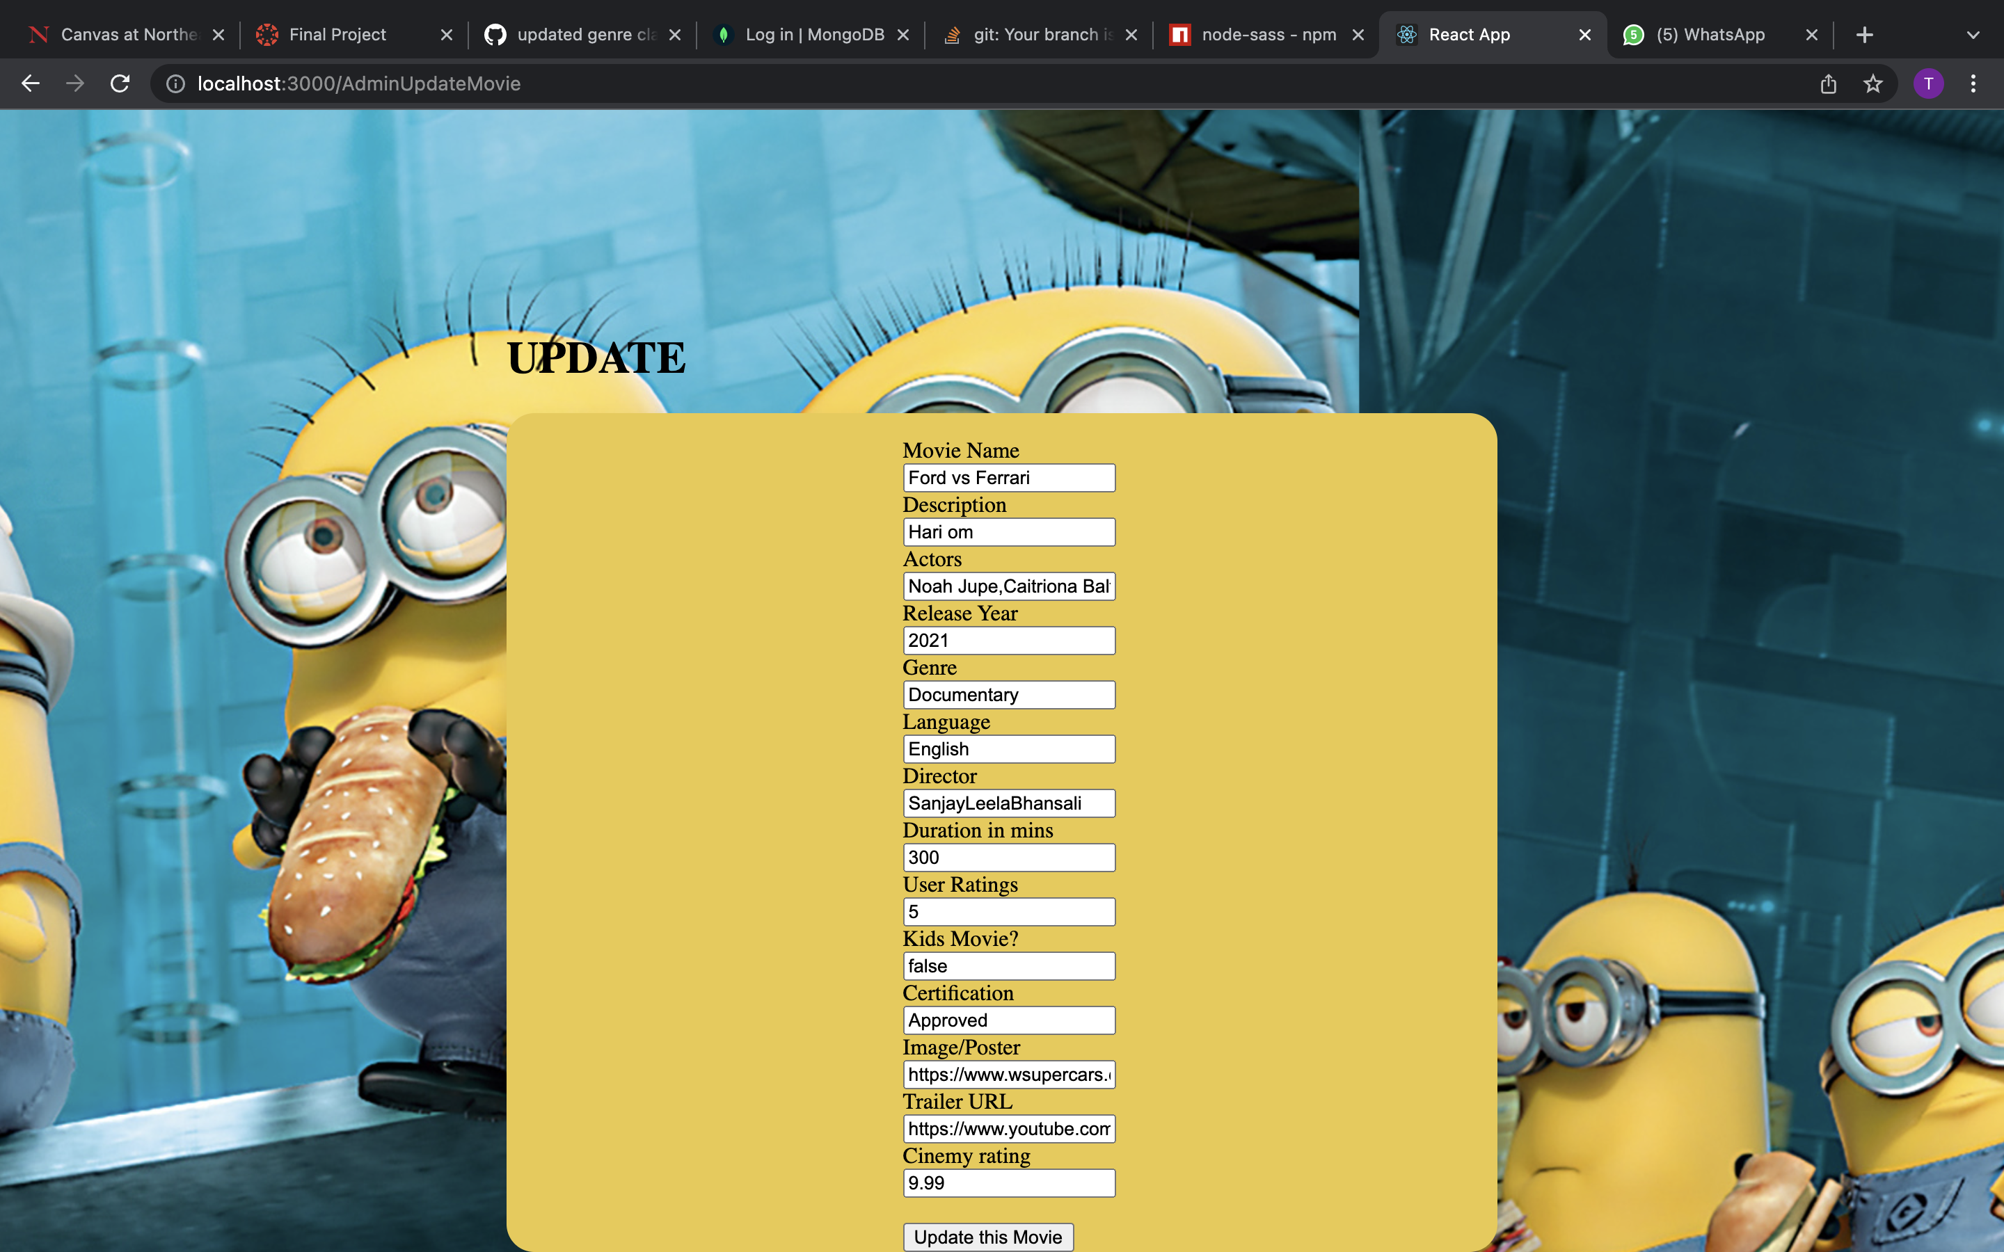

Slide 11
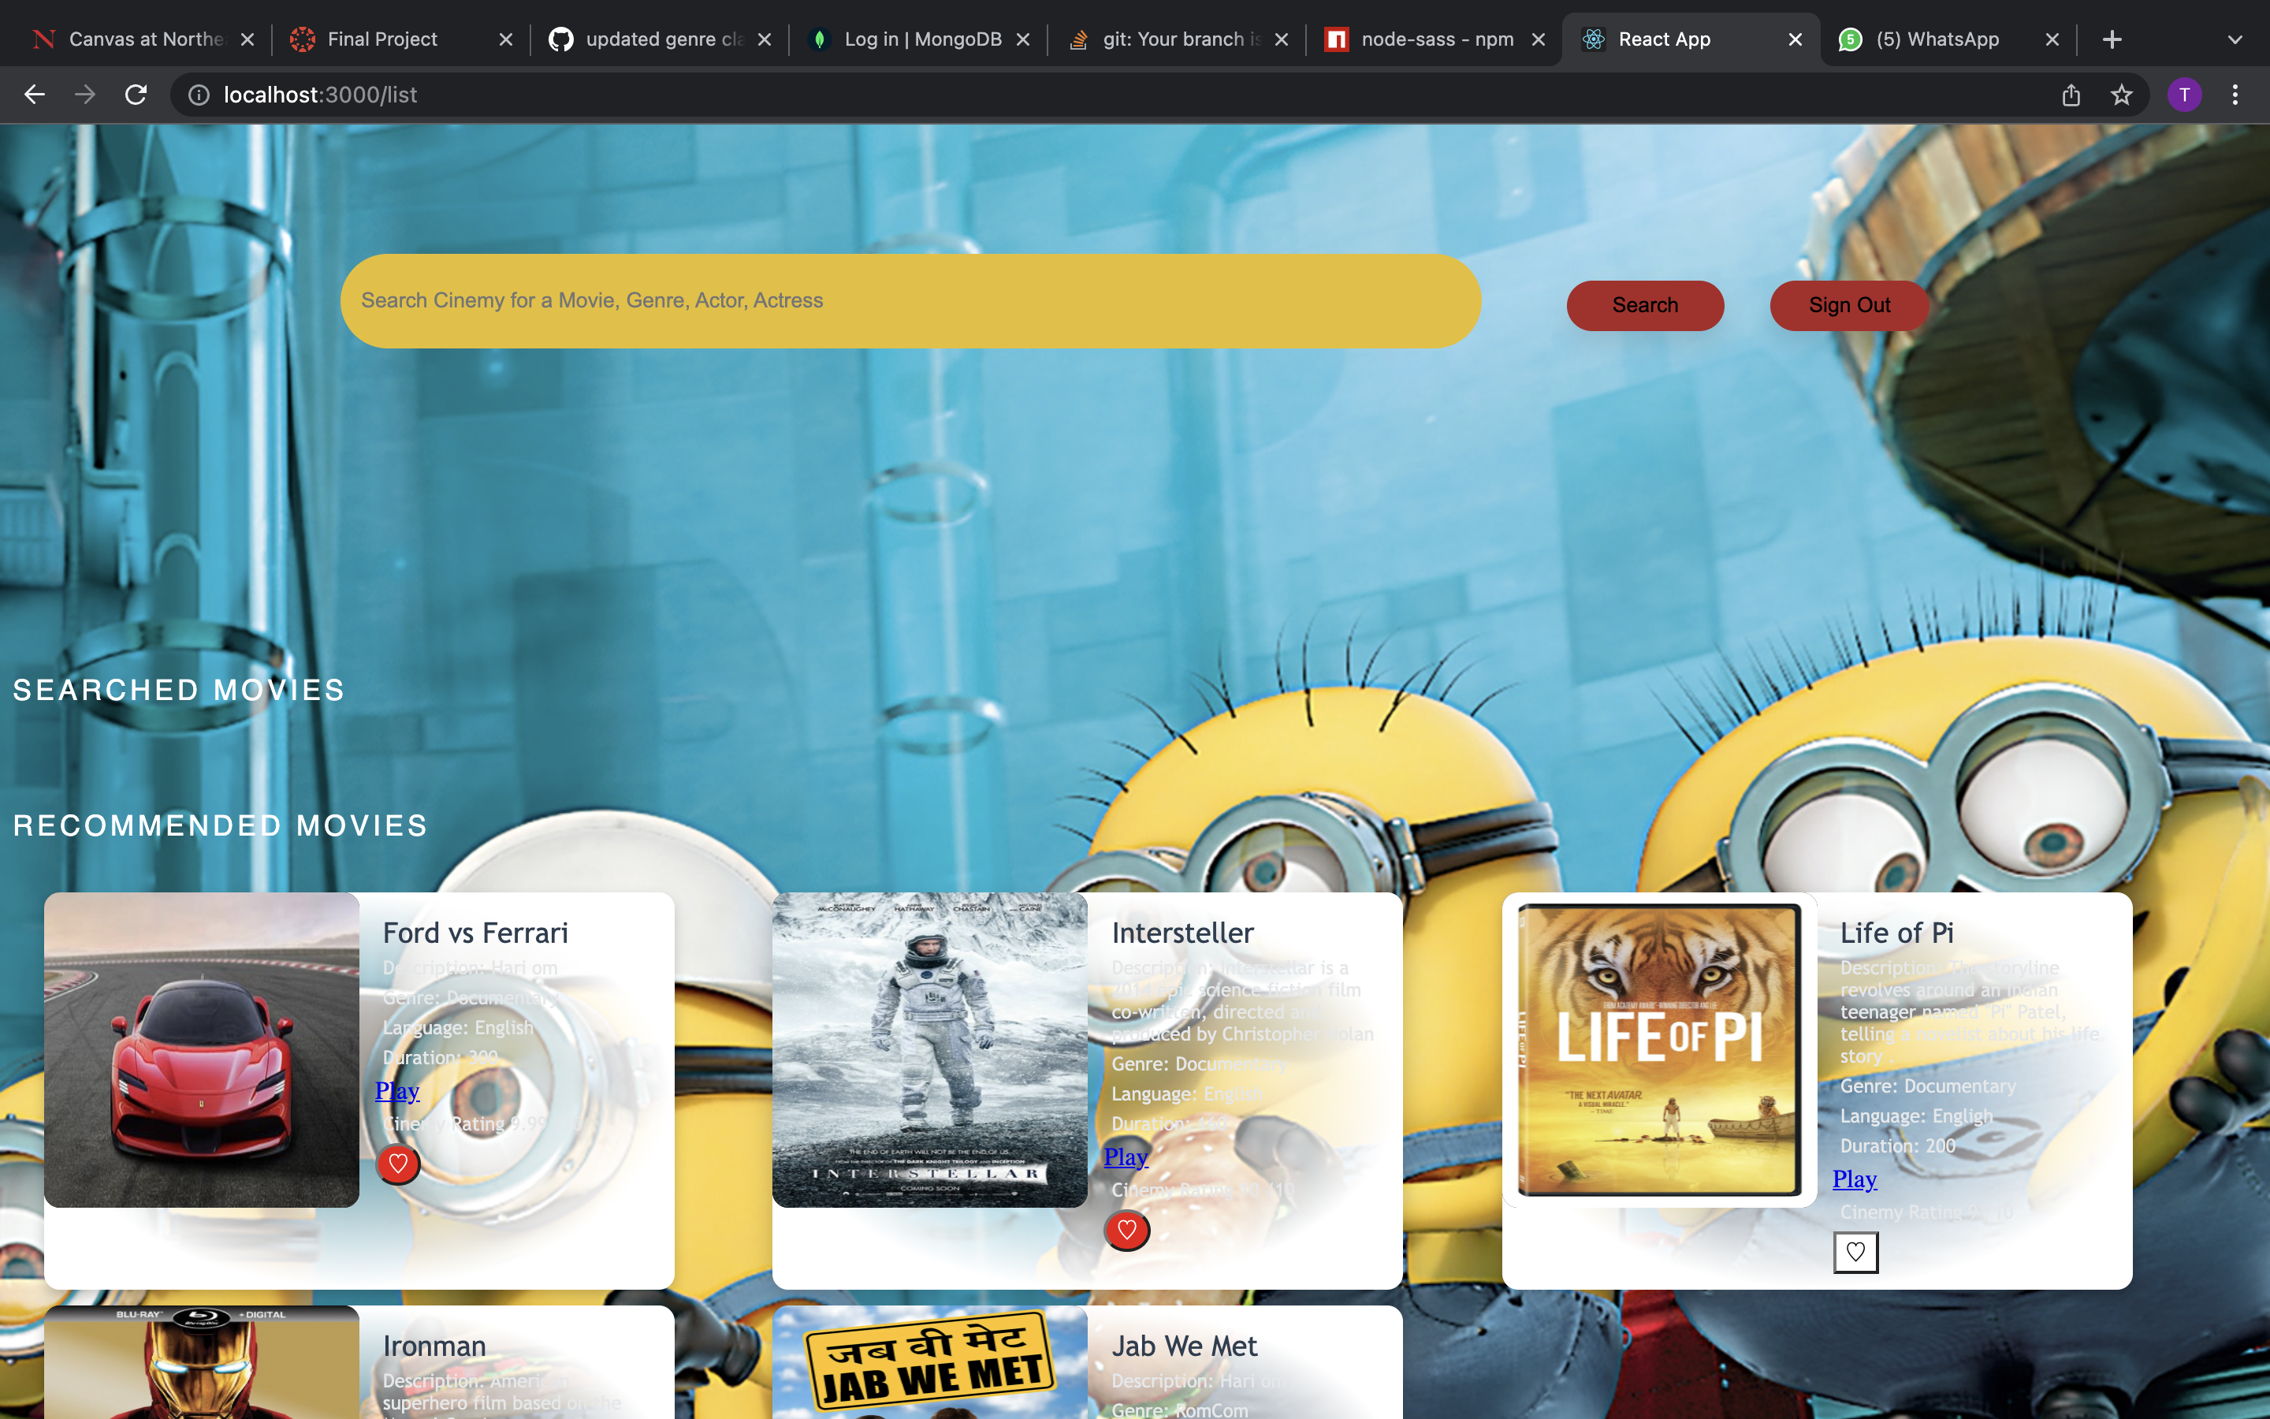

Slide 16
FUTURE SCOPE
Android /iOS
Web-Series
User Reviews
MUSIC
Mars is actually a cold place
Venus is the second planet from the Sun
Saturn is composed of hydrogen and helium
Jupiter is the biggest planet of them all

Slide 17




Contributions
NETRA AWATE
SAKSHI NAYAK
SHREYA BIDARKAR
TARU SHUKLA
Home Page UI
Login UI
Create Movie UI
Funcationality and Styling
Movies API creation
Movie Create and Delete function by Admin
Movie listing by Genre
UI Movie Cards
Search Movie my various parameters
User API creation
Login with JWT authentication
Delete Movie functionality,
Search Movie by Actor in Search bar
Like/ dislike movie feature
Sign-up UI
Admin update and create UI
Genre List
Front-end Functionality and styling

Slide 18
THANK YOU!
DEMO TIME

